Slide 1

Notes:
[BRIEF INTRO]
We are continuing part 1 of our sermon series on the core teachings of Jesus, which are found in what is known as the Sermon on the Mount in Matthew chapters 5-7.
Once again, the Sermon on the Mount has a rather sophisticated structure … [NEXT SLIDE]

Slide 2

Notes:
Starting at the top of this image you can see that the Sermon on the Mount contains 3 major sections, the middle section (main body) itself has 3 parts, and each middle part breaks into 3 parts. If you’re just joining us, we began our series with the first two verses of the choice that Jesus gives us in the conclusion. In Matt. 7:13-14, Jesus said there are two paths, a wide road to destruction and a narrow road to life. And so, we started with the end in mind so that we will keep before us the invitation to walk the narrow path of Jesus.
In week two, we covered the Beatitudes and what Jesus says is “the good life” for those who choose to follow him and enter his Kingdom. God blesses those who embody the good news laid out in the Beatitudes. In week three, we concluded the opening of the sermon with Jesus’ call for his followers to be salt and light in the world—to push back on the darkness and decay of the world with the light of our witness; by embodying the good life of the Kingdom of God.
And then in week 4, Jesus began a new section and taught about a greater righteousness that fulfills the Torah (Law) and Prophets. He believed that the Hebrew Scriptures revealed how we are to live in right relationship with God, our neighbors, and our enemies. But Jesus also claimed that he was uniquely moving the story forward to its divinely intended goal and purpose.
Remember what he said in Matthew 5:17 and 20… [NEXT SLIDE]

Slide 3
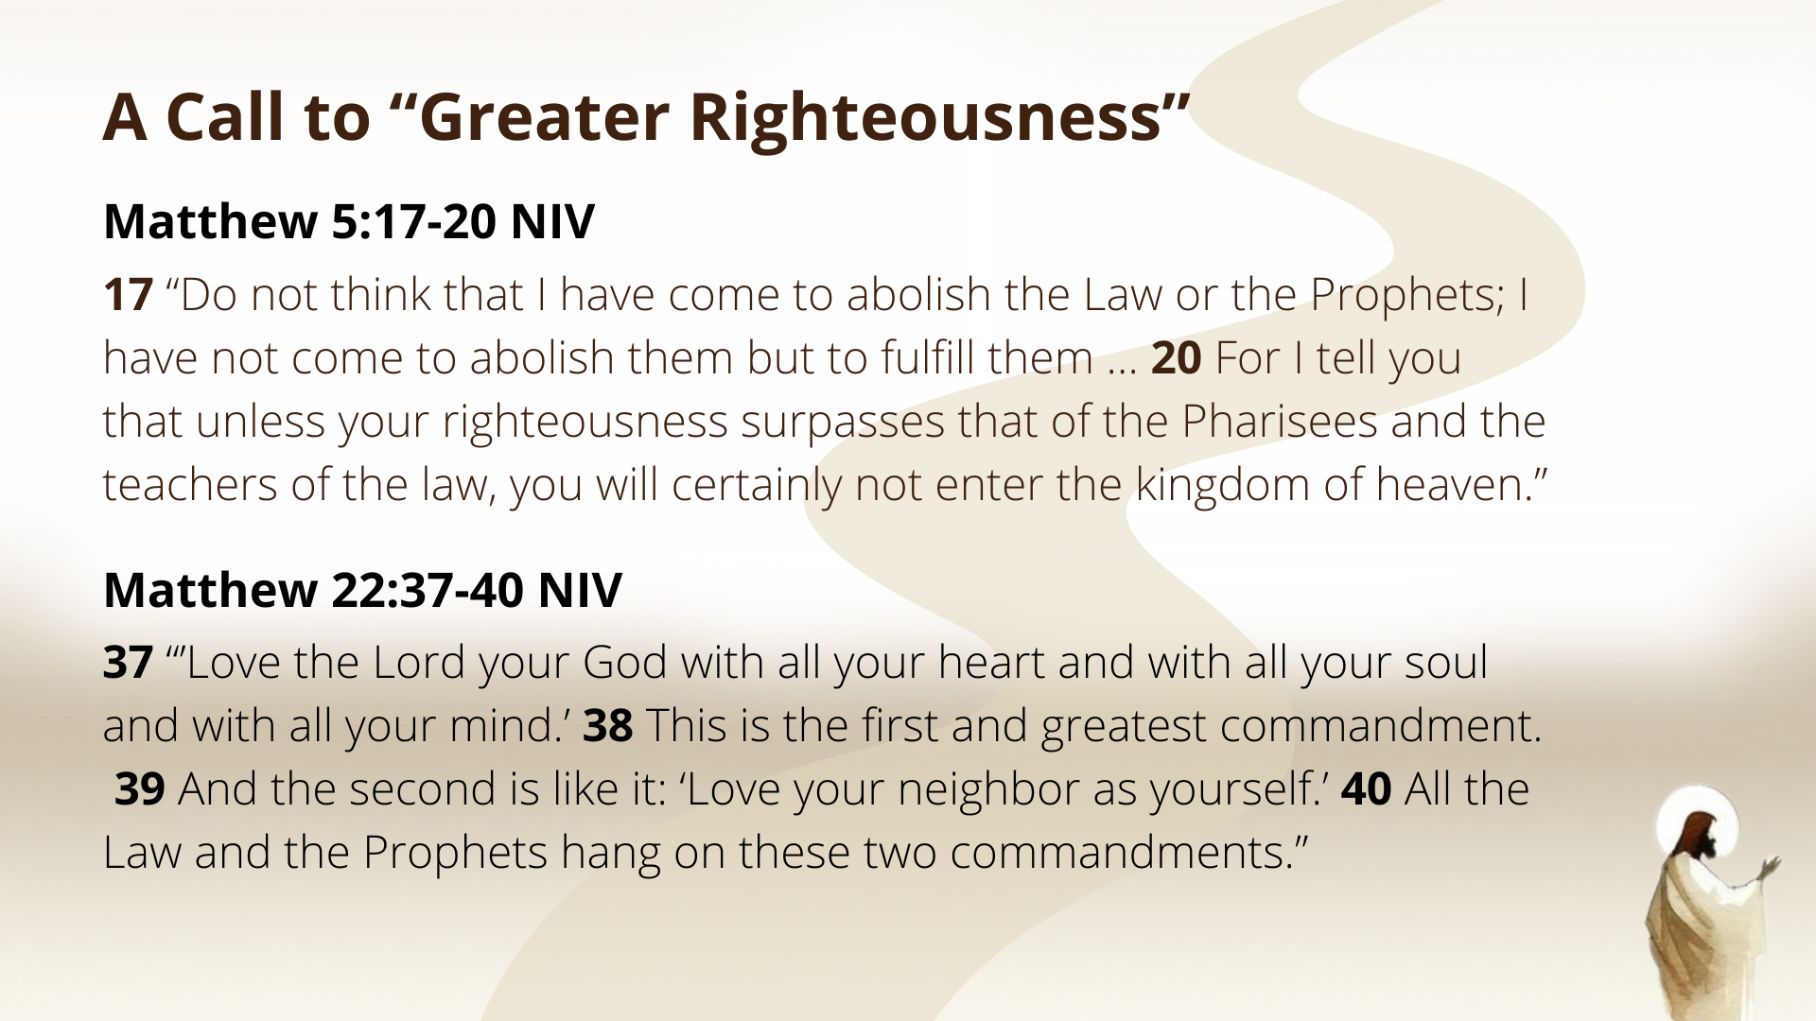
Notes:
[READ & COMMENT ON SCRIPTURE]
Jesus reveals the Law’s true intent and depth
Therefore, as the definitive interpreter of Scripture, Jesus shows us how he interprets the Law with six case studies in Matthew 5:21-48. As we heard last week with Brantley’s message, Jesus begins with the commandment, “Do not murder” (Ex. 20:13). We heard how Jesus isn’t softening or loosening the command but rather going beyond external obedience so that we will examine our heart and the desires that lead to sin. Sure, murder is bad. But if you want to get real serious about following Jesus and entering the Kingdom, you need to deal with the murderous anger you feel inside. So, Jesus isn’t just concerned about our actions, but our inner life as well. How are we viewing and treating other human beings made in God’s image?
You may recall what Jesus said to the Pharisees in Matthew 23:25-26: “Woe to you, teachers of the law and Pharisees, you hypocrites! You clean the outside of the cup and dish, but inside they are full of greed and self-indulgence. Blind Pharisee! First clean the inside of the cup and dish, and then the outside also will be clean.” As you can see, Jesus is concerned about our inner life.
And so, in today’s message, we’re going to hear how Jesus points us beyond external obedience to the next commandment, “Do not commit adultery” (Ex. 20:14), to confront a deeper issue—lust in the human heart. If you’re taking notes, I’ve entitled this message… [NEXT SLIDE]

Slide 4

Notes:
Beauty, Marriage, and Sexual Desire.
Please turn with me to Matthew 5:27-30. And as you’re turning there, please stand with me as we read the words of Jesus together… [NEXT SLIDE]

Slide 5

Notes:
[READ MATTHEW 5:27-30] – This is the word of the Lord. Thanks be to God.
As many of you know, the Bible does not shy away from difficult topics. Some places are PG, and other places are Rated R. And it’s important to point out that everything it records in story form is not necessarily an endorsement of the thinking or behavior, but it’s simply an honest reporting of what happened.
We see that in what the Bible tells us about King David. And when we’re talking about adultery and lust, as it would have likely been in Jesus’ day, the people of God will recall one particular story, which we can read about in 2 Samuel chapter 11… [NEXT SLIDE]

Slide 6
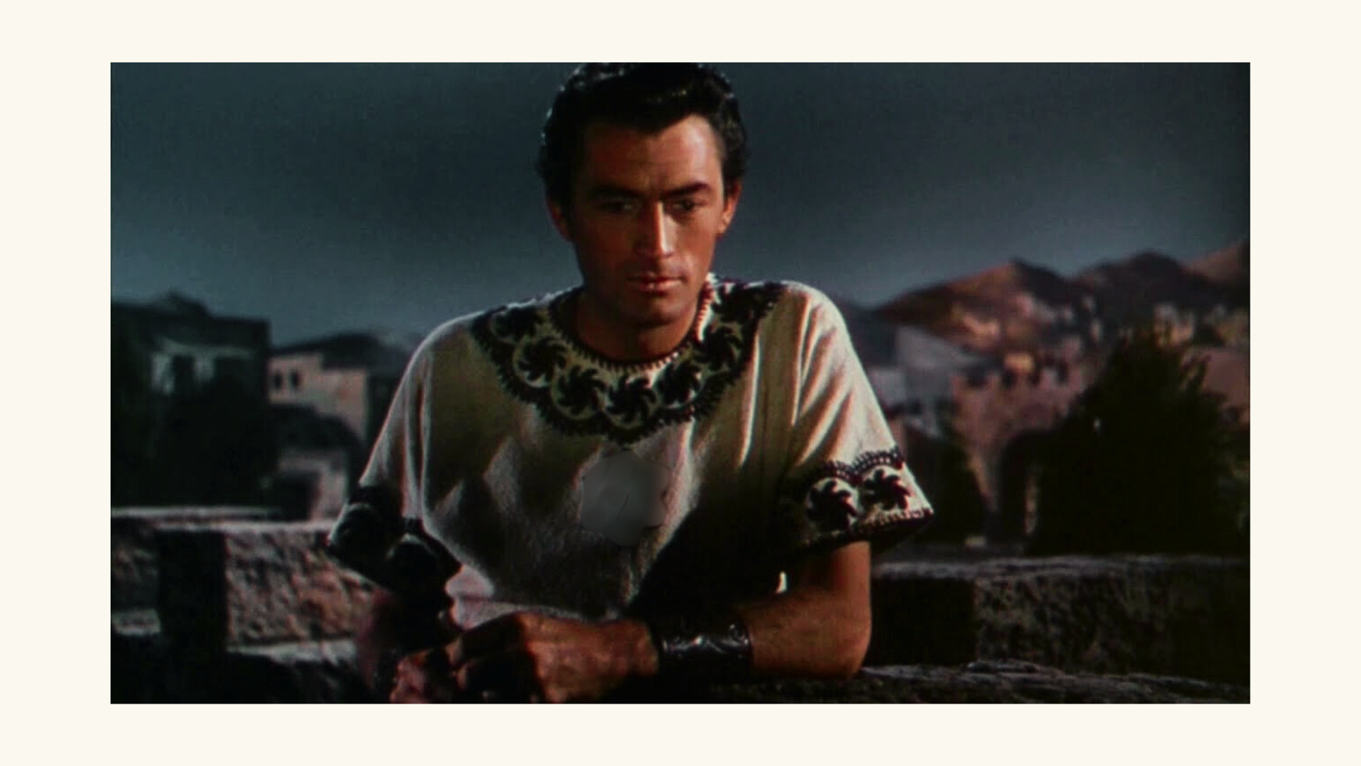
Notes:
First, we read that David is not where he should have been—with his army fighting the Ammonites, but, instead, he was at home living in safety and comfort. One night he goes up to the roof of the palace (maybe he couldn’t sleep or maybe he went there with intentionality… we’re not told), but he sees a woman bathing outside. He watches, he likes what he sees; he then sends someone to find out who she is and then sends messengers to get her; we’re told that he sleeps with her, thus abusing his power and committing adultery with another man’s wife.
And it doesn’t end there, Bathsheba later sends word that she is pregnant; David finds out who her husband is (Uriah, a soldier in David’s army), and after a failed attempt to get him drunk and send him home to be with his wife, David has him placed on the front lines to ensure his death. Of course, his attempt to cover up what he had done fails, because the prophet Nathan confronts David and says God knows what you’ve done, and he tells him that his sins of lust, adultery, greed, theft, and murder will have serious consequences.
It’s a sad and troubling story of the “man after God’s own heart” falling from a place of God’s favor and blessing… and it all started with lust. And so, it’s not difficult to understand why Jesus addresses this issue in his core teachings. Let’s look again at Matthew 5:27-30 and go verse-by-verse, so we can unpack what Jesus means… [NEXT SLIDE]

Slide 7

Notes:
[READ VERSE-BY-VERSE & COMMENT]
v. 27 – “adultery” is having an affair or sleeping with someone who is not your spouse; And in the ancient world, men held the social and sexual power. In fact, ”do not commit adultery” was often only applied to the woman, and not the man. And so, we have records of men sleeping with other women (e.g., slaves or prostitutes), but as long as it wasn’t another man’s wife, they were in the clear. You’ll recall in John 8, the woman who was “caught” in adultery. Where was the man? And what did they want Jesus to do? Stone her (barbarism) or just excuse it?
So, notice what comes next. Instead of addressing the women (who at that time had little power in the relationship, as we will see next week with divorce) Jesus’ teaching is going to directly confront male-dominated patterns of objectification and exploitation. Jesus calls out the men.
v. 28 – “looks at a woman lustfully” – “look” in the Greek is a present active participle, which means the looking is ongoing. In other words, Jesus is talking about a long gaze or a stare for self-gratification, to illicit desire, and/or for the purpose of sexual fantasy.
To be clear, Jesus is not condemning normal attraction or noticing beauty; rather, He’s exposing lustful intent — the deliberate act of looking at another person in order to desire them sexually. And though we like to imagine that we are so much more advanced and enlightened than those in ages past, we clearly have a problem today with lust and the objectification of others.
Take a look at these statistics Rich Villodas mentions in his book… [NEXT SLIDE]

Slide 8

Notes:
[READ & COMMENT ON SLIDE]
And you can just Google this, the global pornography market was valued at approximately $287.8 billion in 2023 and is projected to grow significantly in the coming decade. And as disciples of Jesus, we must take this seriously. And while we may not be able to do much globally, or even nationally, we can certainly do something as it pertains to our own lives, to the lives of our children, and to the faith community we call Grantham Church.
Listen to what the Apostle Paul wrote… NEXT SLIDE]

Slide 9
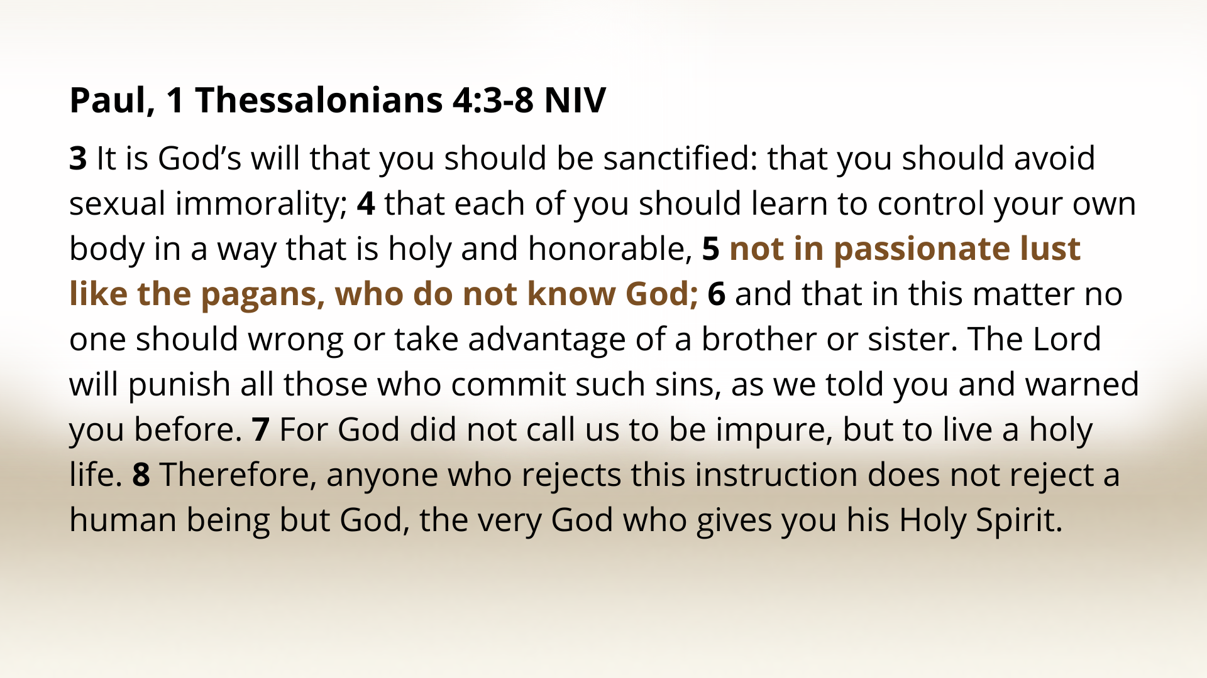
Notes:
[READ & COMMENT]
So, church, it’s time to recover a ”biblical” view of marriage and the Christian vision of sexuality. And by “biblical” we mean that, according to Genesis 3 and Jesus in Matthew 19, God created sex to be enjoyed as a “one-flesh” union within the confines of a sacred, covenant relationship. Have you ever read Song of Songs? Folks, we have an entire book of the Bible that is erotic poetry meant to glorify God’s gift of sex within the covenant of marriage.
Sure, there are plenty examples of people not living up to this standard in the Bible, but Jesus reminds us that it is God’s design and original intent that leads to human flourishing. And when our sexual desires are expressed outside of covenant marriage, it leads to societal harm.
And so, think about it… lust… is anti-love. It’s antithetical to the gospel. It degrades the image of God in others. It doesn’t lead to the greater righteousness that Jesus desires for us. Lust is an unhealthy, dehumanizing practice. It devalues the one lusting and the one being lusted for. It objectifies another person, and is a form of theft, greed, and abuse.
And Paul says it’s a form of idolatry. Listen to what he says in Colossians.. [NEXT SLIDE]

Slide 10
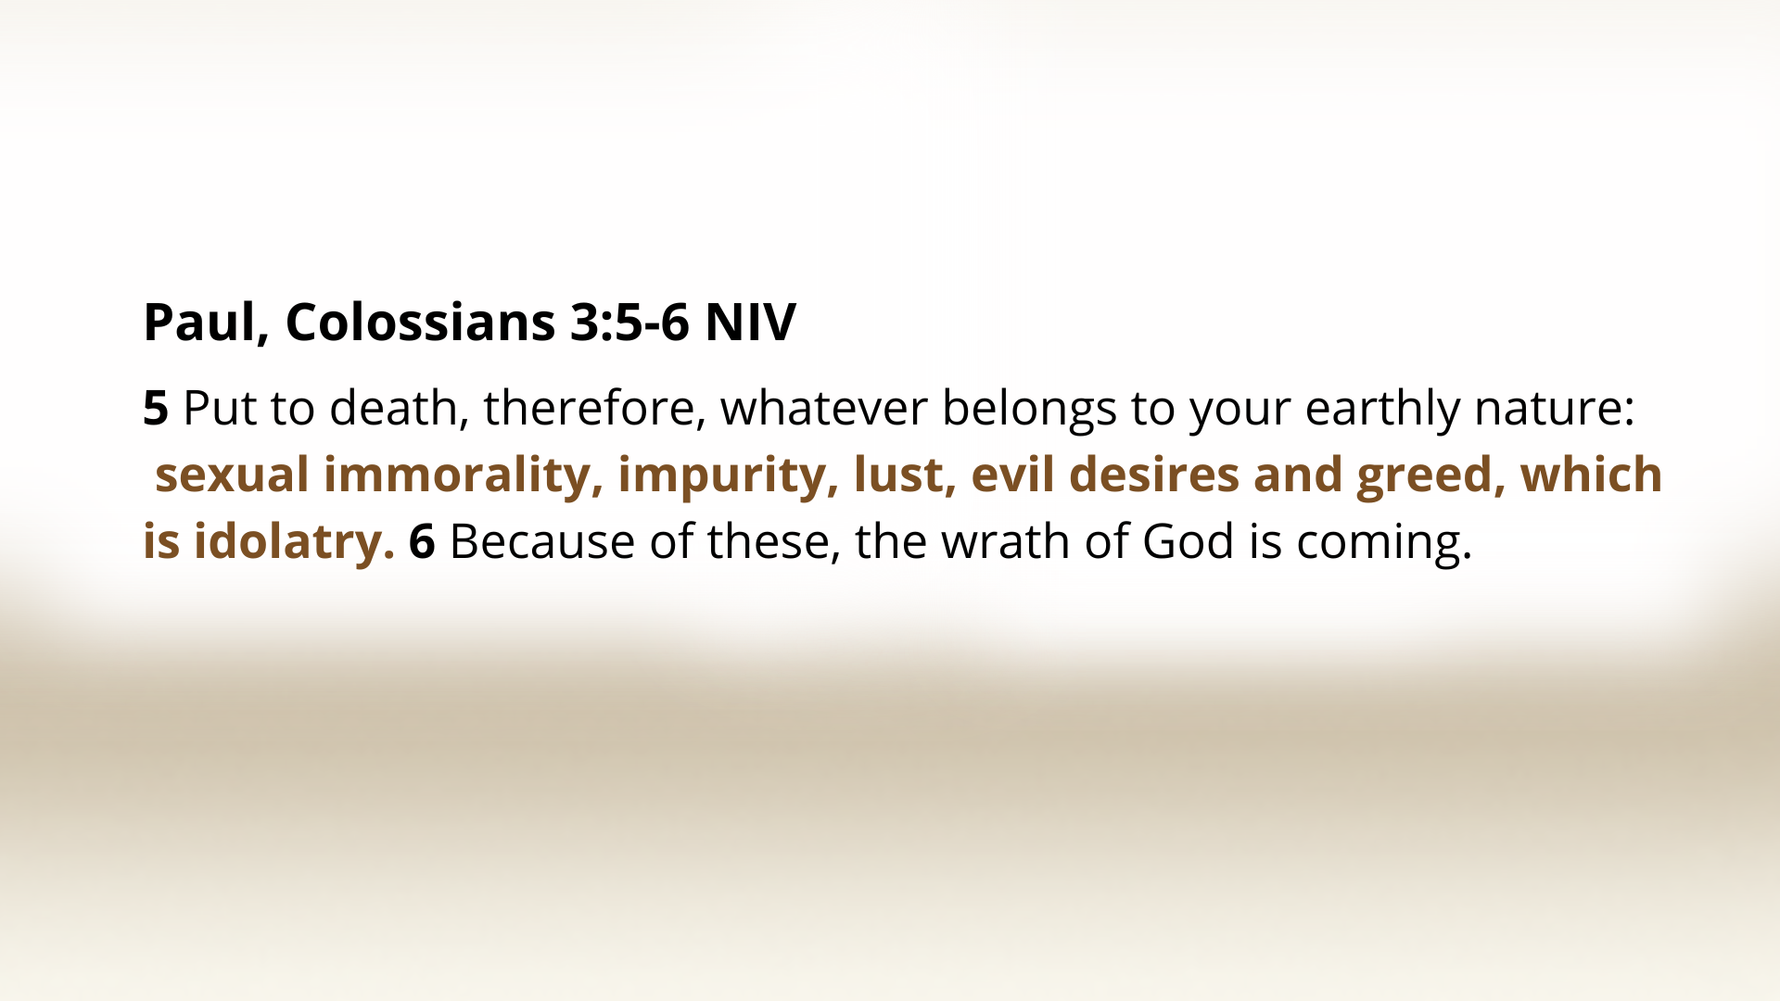
Notes:
[READ & COMMENT]
It begs the question: How have made an idol of sexual desire and expression today?
Also, what ways are we currently seeing “the wrath” of God poured out (e.g., Romans 1)?
And so, with the seriousness and weightiness of this problem in mind, let’s listen to what and why Jesus says what he does in Matthew 5:29 and 30… [NEXT SLIDE]

Slide 11
Notes:
[READ VERSE-BY-VERSE & COMMENT]
vs. 29 & 30 – Say what, Jesus? Don’t’ miss this. Jesus is speaking in graphic hyperbole, not literally prescribing self-mutilation. And in first-century idiom, the “right eye” and “right hand” symbolized a person’s best or most valuable faculties—what one most depends on.
The exaggerated language underscores the radical seriousness with which disciples must deal with sin. Why? Because lust will not stay hidden and undercover for long. In time, it will show up in visible ways, e.g., how you see and talk to women; it will increase your desire to satisfy your lusts, usually meaning acting it out in some way, and often leading to further sexual deviations. Not to mention what it does to your brain, your self-esteem, and your relationships. It all, ultimately, according to Jesus, leads to hell.
And so, Jesus’ call means: “Be willing to remove anything—no matter how valuable—that leads you into sin. Deal decisively with temptation before it takes root.” Listen to how James writes about temptation and desire in his wisdom epistle… [NEXT SLIDE]

Slide 12
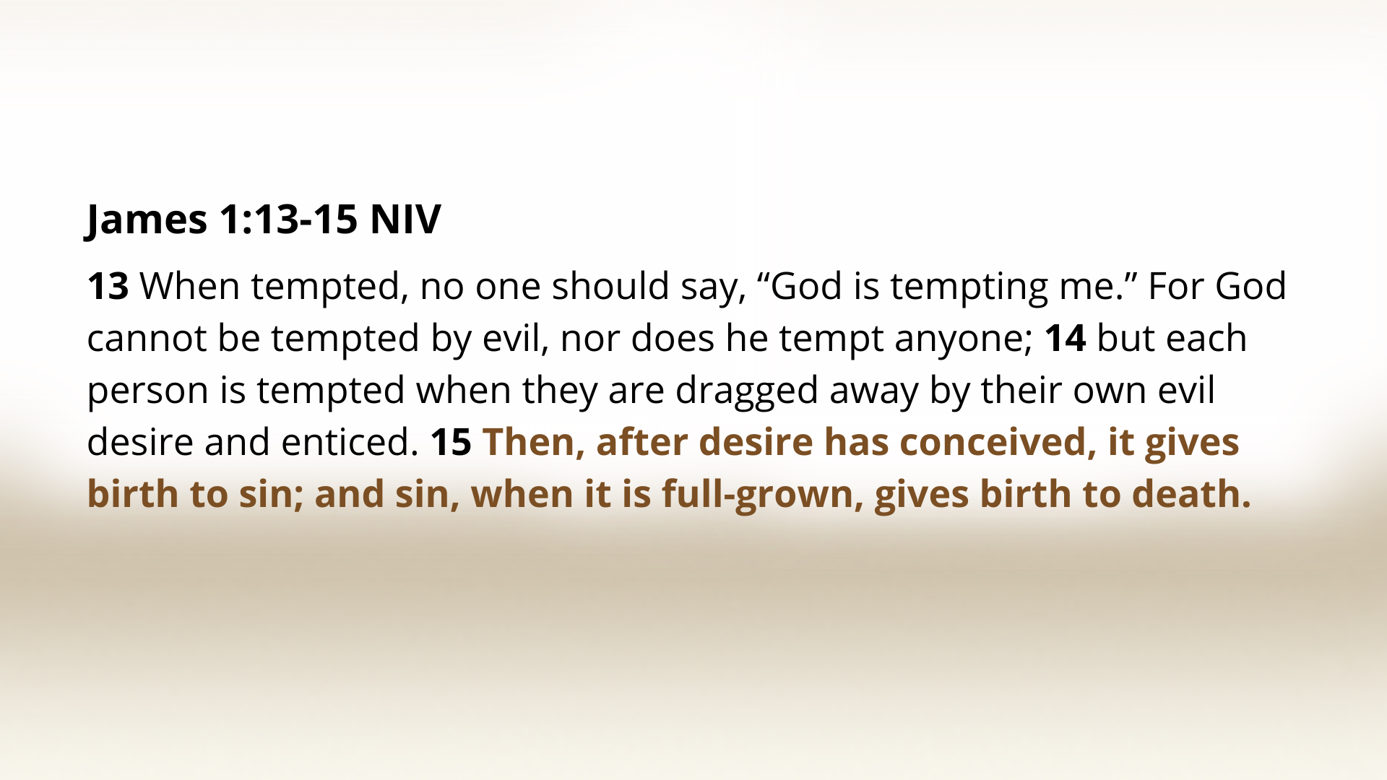
Notes:
[READ & COMMENT]
Notice that James says that the sinful desires, including our sexual desires, are our own responsibility. It begins in us and must be dealt with first and foremost in that way. While it may be true that we live in a hypersexualized and hedonistic culture where certain men and women do dress provocatively, and their clothing (or lack thereof) seems to be a welcome mat to their body, the Scripture puts the emphasis on you, your eyes, your hands, and your desires.
But we also recognize, as James does, that there is an unseen enemy at work in the sinful strongholds of our lives, which is why he goes on to say this… NEXT SLIDE]

Slide 13
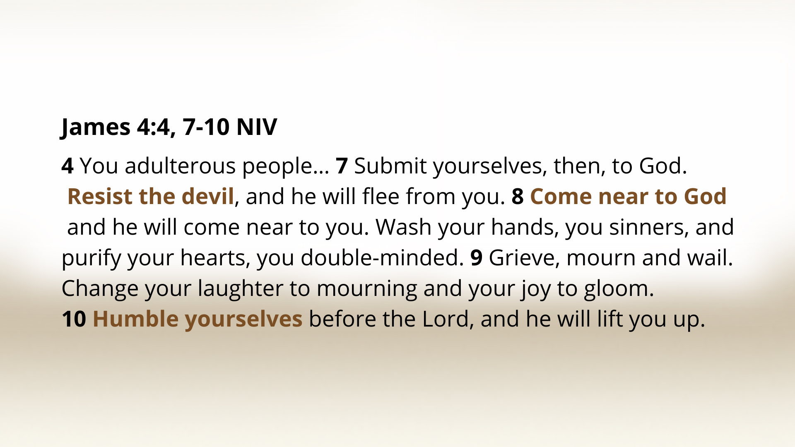
Notes:
[READ & COMMENT]
What is the posture of a disciple when it comes to our sins? It is grief over the recognition of our sins and our weakness, but hope in the mercy, grace, and love of God. That is why if we “humble” ourselves—recognizing our need for God—he can deliver us from the bondage of our sins.
So, first, adopt this posture and approach. And then, consider responding to lust with one or more of these spiritual disciplines and communal practices… NEXT SLIDE]

Slide 14
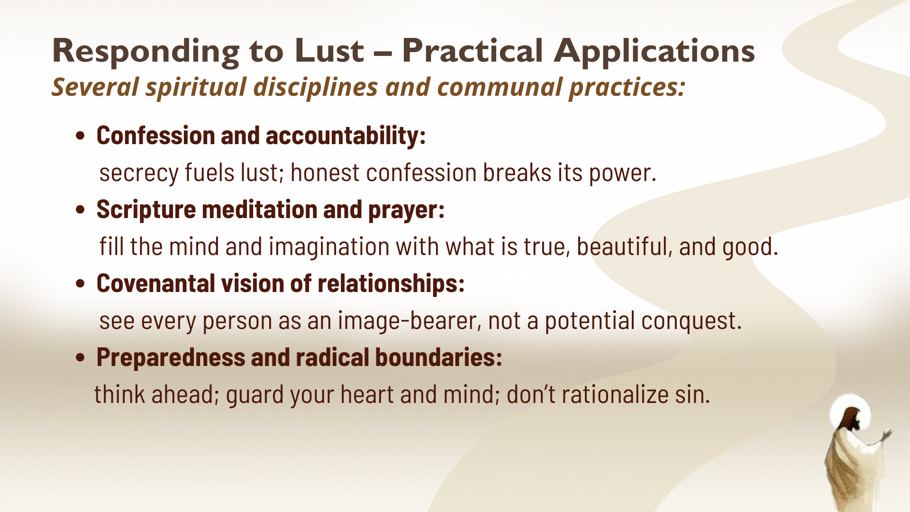
Notes:
[READ & COMMENT ON SLIDE] NOTES ON EACH POINT:
Confession and accountability: this can be your spouse or a friend; it can happen one-on-one or in an intimate space like an intentional discipleship group
Scripture mediation and prayer: you can’t just remove something or try not to think about something, you have to fill your heart and mind with better things
Covenantal vision of relationships: discipline yourself; when you see someone and want to objectify them, see them as your daughter, your brother, or your sister
Preparedness and radical boundaries: if you know your vulnerable at certain times, then be ready for it; put the phone away; don’t go there; do whatever it takes
In his commentary on the Sermon on the Mount, John Stott clarified for us what Jesus meant: “if your eye causes you to stumble, don’t look; if your foot causes you to stumble, don’t go; and if your hand causes you to stumble, don’t do it” (pg. 70).
Friends, Jesus wants us to take our inner life seriously. If there is unchecked lust, as we saw last week with anger, then we must give attention to it before it grows into something much worse. Think about it this way… [NEXT SLIDE]

Slide 15

Notes:
Imagine you drop your phone on the pavement. The screen shatters—small spiderweb cracks appear everywhere—but it still works. So, you decide not to fix it. You say, “It’s just a screen. I can still see what I need to see.” But over time, the cracks grow. Dust gets in. The touch screen stops responding in places. And one day, after a rainstorm, moisture seeps through those tiny fractures. The phone shorts out completely.
And then you have the thought, “I should’ve fixed it when the first crack appeared.” And that’s how we need to hear what Jesus is saying about lust. He’s not just warning us about adultery—the big, obvious sin that wrecks marriages and families. He’s talking about the cracks that form in the heart long before anything public or visible happens. Because when people fall, they fall in private long before they fall in public. It’s the small compromises of the imagination. The quiet indulgence of the eyes. The “it’s just a little thing; no one will know” moments that grow into something destructive.
That’s why Jesus says, “If your right eye causes you to sin, tear it out.” Not because He wants us to live maimed or in fear or shame, but because he knows that cracks in the heart, if left unattended, can destroy our capacity to love the way God intended us to love. He doesn’t want mutilation; he wants liberation. And the good news of the kingdom is this: Jesus doesn’t just cover the cracks—He makes us whole again. He doesn’t call us to purity to shame us, but to set us free; so that we can be healthy and whole and love others well.
Brothers and sisters, Jesus invites us to know freedom from the enslaving power of lust by transforming our desires and teaching us to love others made in his image. In an age that markets bodies and monetizes desire, we’re called as Jesus’ disciples to bear witness to the kingdom by embodying holiness, honor, purity, respect, and covenantal love. May the Spirit help us to do that, as we seek to lead others to the God who looks like Jesus. Amen?
Finally, here are some questions to help us reflect and respond together… [NEXT SLIDE]

Slide 16


Slide 17
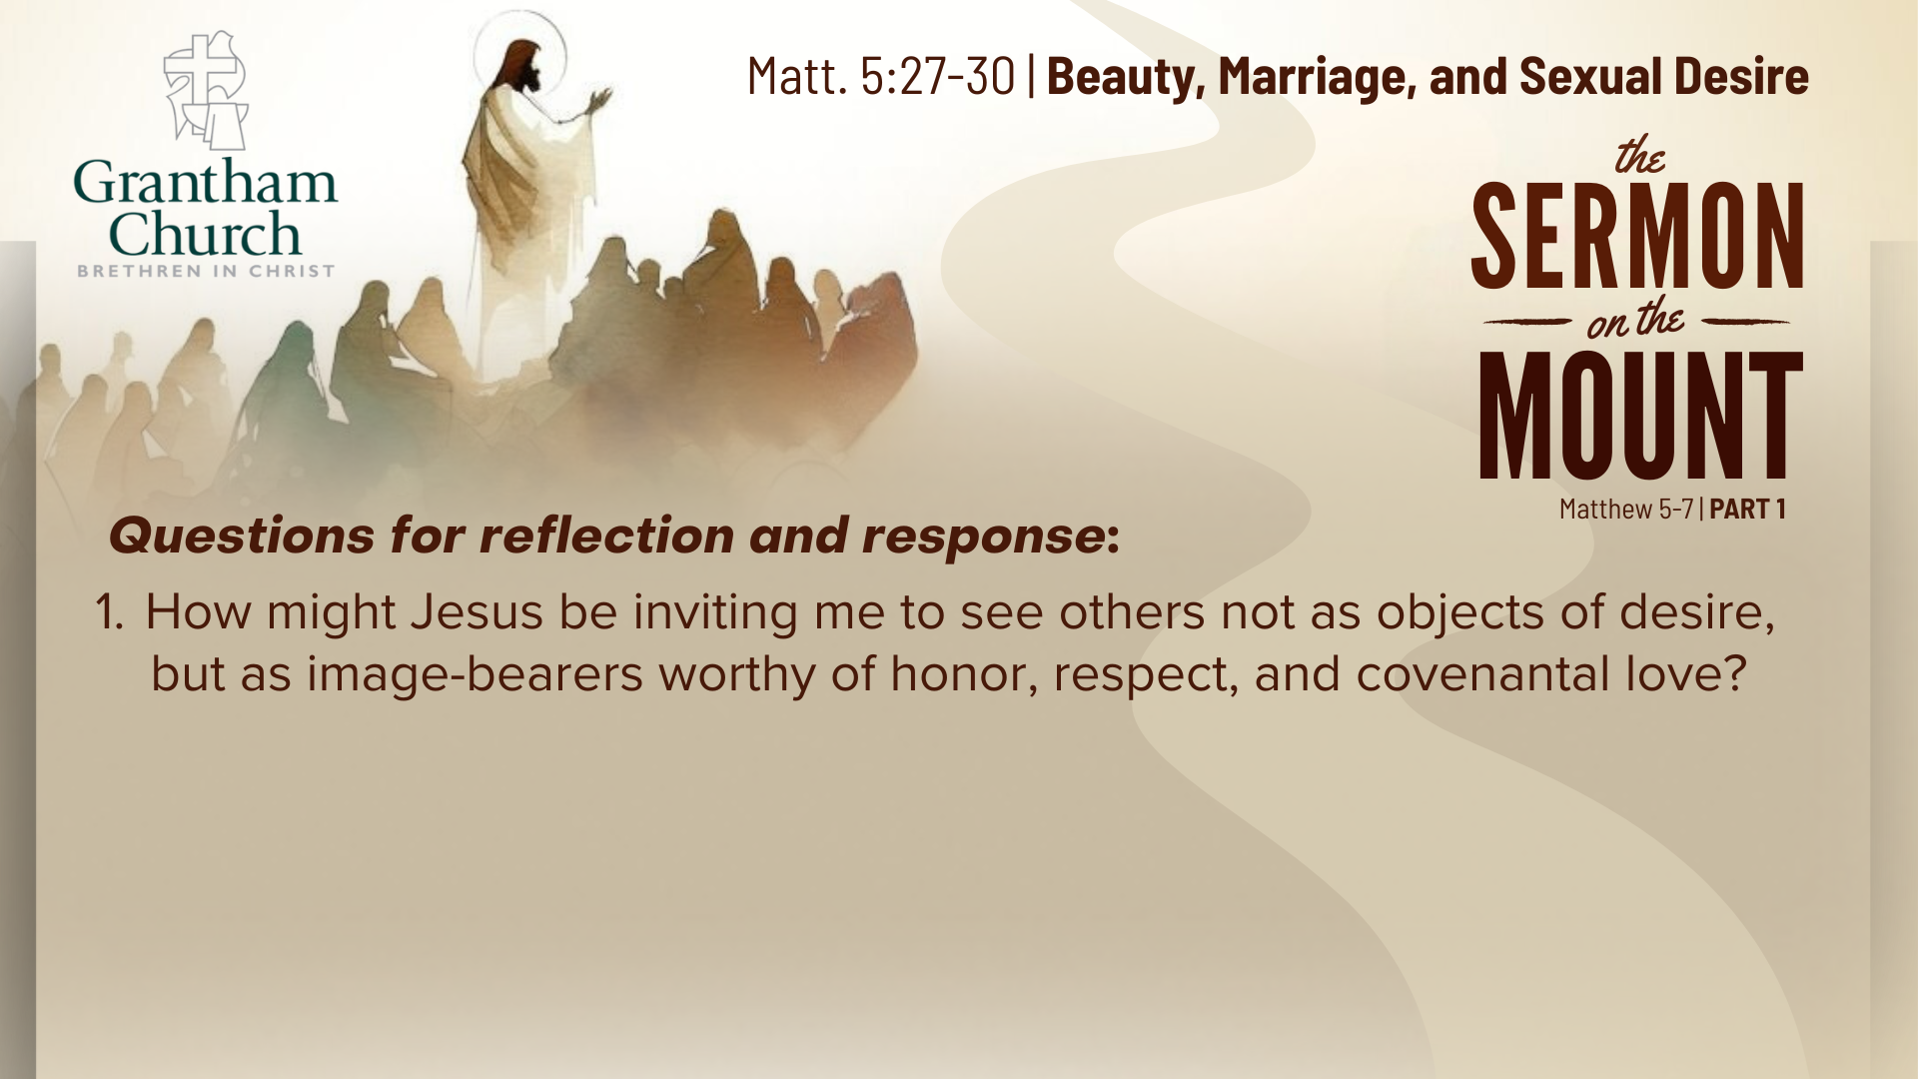

Slide 18


Slide 19

Notes:
[READ & BRIEF COMMENT ON EACH QUESTION]
How might Jesus be inviting me to see others not as objects of desire, but as image-bearers worthy of honor, respect, and covenantal love?
What practical, even radical, steps might Jesus be calling me to take to guard my heart, and then redirect it to life and love in the Kingdom?
Instead of shame or hiding, how is the Spirit inviting me to confess my sins so Jesus can bring healing, freedom, and integrity in my inner life?
[CLOSING WORDS]
Let’s pray… [NEXT SLIDE FOR CLOSING PRAYER]

Slide 20

Notes:
Lord Jesus, you have called us to a righteousness that goes deeper than rule-keeping—a purity of heart that reflects the light and love of God. We confess that our eyes have wandered, our hearts have desired what is not ours, and our imaginations have not always honored others as your image-bearers. Yet you do not condemn; You invite us into freedom. You call us out of secrecy and shame, and into the light of Your mercy and truth.
So, Lord, create in us clean hearts. Renew right desires within us. Teach us to see others with Your eyes—with compassion, not consumption; with honor, not objectification; with love that builds up, not lust that tears down. Give us courage to take whatever steps are needed to guard our hearts and live as whole people before you.
May your Spirit fill every part of us—mind, body, and soul—so that our lives bear witness to the beauty of Your kingdom. We rest not in our strength, but in your grace, and we thank you that in you, purity and mercy meet. In your holy name we pray, Amen.
[CLOSING SONG]
ANNOUNCEMENTS: “Navigating Human Sexuality in a Third Way” special learning community event (last day to register!) and “College Student Lunch” right after the service
Benediction
Brothers and sisters, you have heard the words of Jesus and the call to follow him. The path is narrow, but it leads to life. Remember that Christ walks with you, the Father surrounds you, and the Spirit empowers you. Therefore, go in peace, to love and serve the Lord. Amen.

